Slide 1




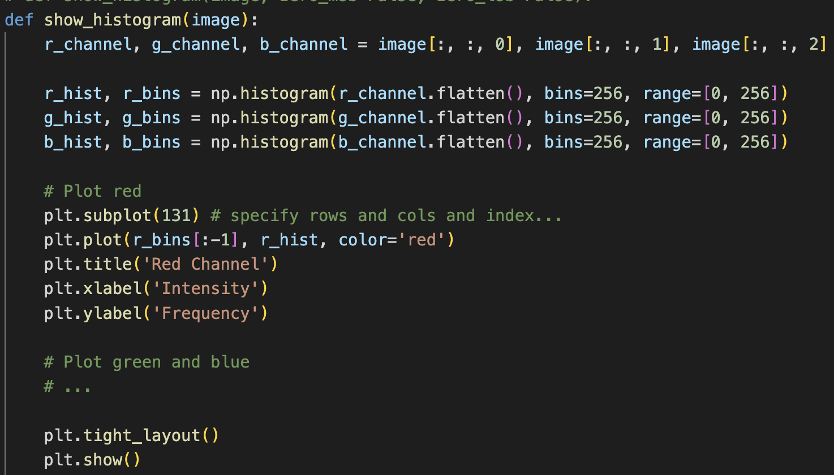
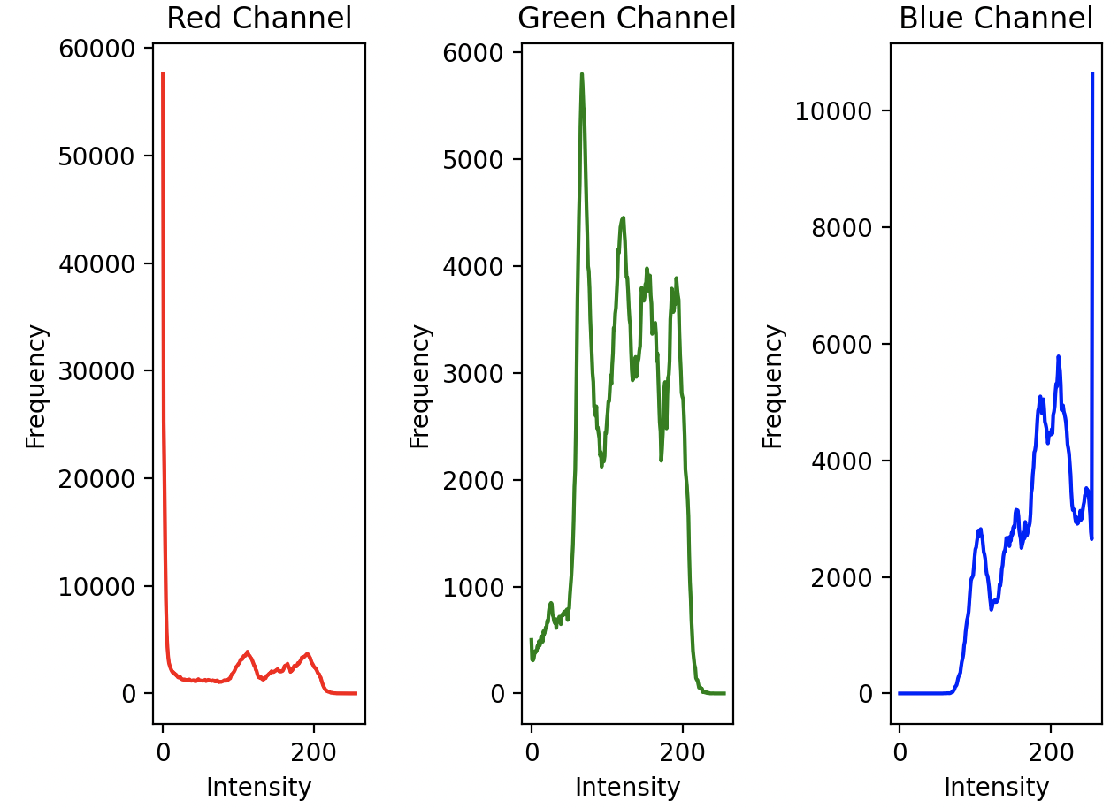

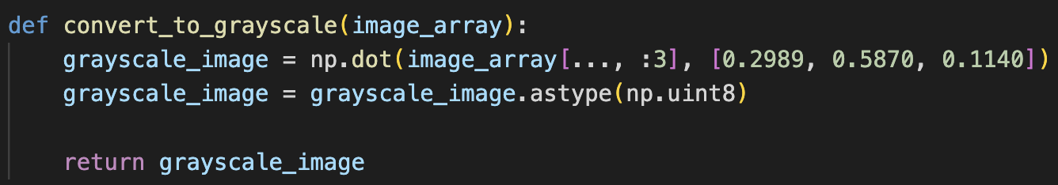
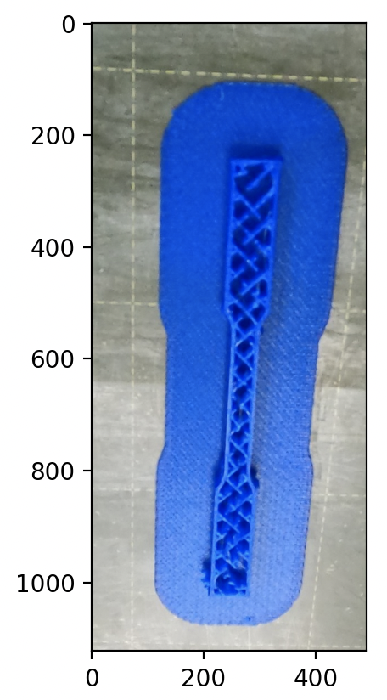
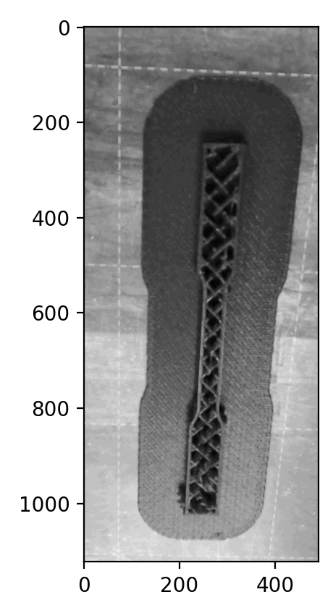
IRES Property Predictions of the Additively Manufactured Components using the Machine Learning Approach
Shrihit Saxena¹, Roger Li², Deepak Sharma³, Krisha Shah⁴
1. Stevens Institute of Technology 2. New York University 3. Indian Institute of Technology, Roorkee 4. National Institute of Technology, Karnataka
PI: Dr. Nikhil Gupta; Mentors: Dr. Mrityunjay Doddamani, Dr. AKM Samsur Rahman, Dr. Caleb Beckwith
Abstract
Exploration and Findings
Conclusion
The topic deals with using ensemble and automated machine learning algorithms to predict the mechanical properties of 3D printed composite. ML algorithms use historical data as input to predict new output values. The role of AI using ML techniques in manufacturing has significantly enhanced in the last five years. It helps to automate the additive manufacturing process without the operator's intervention depending on the available data of the printed object. The complex material parameters and the different 3D printing parameters make them experimentally investigated, making it an expensive, tedious, and time-consuming proposition. The topic uses the ML approach to predict the mechanical properties of 3D printed composites. AutoML is explored for response predictions which can automate the time-consuming, iterative tasks of other ML model development. The students will be exposed to industry-standard machine learning tools and libraries in the Python programming language.
In conclusion, the integration of machine learning and image processing stands as a transformative leap forward in the world of visual data analysis and interpretation. These two fields are able to extract meaningful insights and patterns from complex visual data sources. Machine learning algorithms, with their ability to learn and adapt from vast datasets, enable image processing to transcend traditional limitations, enhancing accuracy, speed, and the overall efficiency of image analysis.
The continuous advancements of algorithms, in combination with advances in hardware capabilities, unlocks an even greater potential for automating tasks and making informed decisions based on visual information. By harnessing the relationship between machine learning and image processing, a new era of insights, applications, and innovations are being discovered and these have the potential to impact a variety of industries.
In order to facilitate the process of collecting a large dataset that will be used to train an accurate ML model, we decided to use image processing and machine learning to automate the process of assessing the physical properties of 3D printed structures. Python libraries, such as OpenCV and NumPy, were used to evaluate the qualities, such as the contrast and exposure, of each image by looking at the image’s histogram. Then the images were adjusted to make it easier for us to train the image recognizing neural network using these adjusted images.
Background
Works Cited
Composite materials have gained significant attention in engineering and manufacturing due to their exceptional mechanical properties and adaptability. These composite parts provide significant weight reduction, more design variety, and in some cases enhanced performance. The emergence of additive manufacturing (AM) has revolutionized composite production, allowing intricate designs and complex structures while minimizing material waste. However, accurately predicting the mechanical behavior of additively manufactured composites remains challenging due to the multitude of processing parameters involved.
To address this issue, researchers are turning to machine learning (ML) algorithms as a potential solution. By leveraging historical data on materials and printing parameters, ML algorithms can predict the mechanical properties of new composite structures. Ensemble learning techniques and automated ML approaches enhance prediction accuracy and streamline model development, reducing the need for extensive experimental trials. Ensemble learning techniques involve the user combining multiple ML models to create an improved product. While automated ML is when the program selects the appropriate ML model parameters for the specific task.
Image processing utilizing these ML techniques allow for the further allow for the understanding of mechanical properties of these composite materials through observing the formation of the materials after being processed. Further refinement using a large dataset of images at higher resolutions and magnifications will yield a greater scope of information.
Girshick, R., Donahue, J., Darrell, T., & Malik, J. (2014). Rich feature hierarchies for accurate object detection and semantic segmentation. In Proceedings of the IEEE conference on computer vision and pattern recognition (pp. 580-587).
He, K., Zhang, X., Ren, S., & Sun, J. (2016). Deep residual learning for image recognition. In Proceedings of the IEEE conference on computer vision and pattern recognition (pp. 770-778).
LeCun, Y., Bengio, Y., & Hinton, G. (2015). Deep learning. Nature, 521(7553), 436-444.
Long, J., Shelhamer, E., & Darrell, T. (2015). Fully convolutional networks for semantic segmentation. In Proceedings of the IEEE conference on computer vision and pattern recognition (pp. 3431-3440).
Ronneberger, O., Fischer, P., & Brox, T. (2015). U-Net: Convolutional networks for biomedical image segmentation. In International Conference on Medical image computing and computer-assisted intervention (MICCAI) (pp. 234-241).
Simonyan, K., & Zisserman, A. (2014). Very deep convolutional networks for large-scale image recognition. arXiv preprint arXiv:1409.1556.
Szegedy, C., Liu, W., Jia, Y., Sermanet, P., Reed, S., Anguelov, D., ... & Rabinovich, A. (2015). Going deeper with convolutions. In Proceedings of the IEEE conference on computer vision and pattern recognition (pp. 1-9).
Zhang, K., Zhang, Z., Li, Z., & Qiao, Y. (2016). Joint face detection and alignment using multitask cascaded convolutional networks. IEEE Signal Processing Letters, 23(10), 1499-1503.
Figure 1. Python function responsible for generating and showing histogram.
Figure 2. Histogram of example image.
Figure 3. Python function that’s responsible for converting image to gray scale.
Acknowledgements
Thank you to NYU Tandon School of Engineering, New York City College of Technology, and Indian Institute of Technology at Mandi for planning, hosting, and supporting this research project. Thank you to The National Science Foundation (NSF) and International Research Experience for Students (IRES) summer program for funding this research, as well as to the graduate students and professors who assisted and guided this project by providing materials and knowledge.
Figure 4-5. Original test image and test image after grayscale conversion

